Slide 1
Locus (Location focus)
Abhishek Pimple
Adhip Vihan

Slide 2
Agenda
Introduction
Previous related work
Motivation
Problems to be addressed
How we have solved those problems?
System evaluation
Conclusion

Slide 3
Introduction
Mashup project
Locus is all about Location focus
Considered things which matters most to the user about new location
Current weather and weather forecast
Popular places to eat
Popular events happening around
Best things to explore - What people have said about it?

Slide 4
Previous Related work
Google search has certain features such as
Weather forecast
Popular events
Best places to eat
Best points of interest
But there are certain limitations
Displays all events and doesn’t allows filtering
eg. filter by music or date etc.
Restaurants comes up with user explicit query search
eg. “popular restaurants in buffalo new york”
There is not a one stop solution

Slide 5
Motivation
Weather forecast, restaurants, events and things to explore
“To build a single application to provide relevant data pertaining to user entered location on good user interface”
Mashup: Unified Interface
City name or Zipcode
Modular, easy to understand

Slide 6
Problems to be addressed
User is unfamiliar about new location
User wants to explore things of relevance
Relevant data includes:
Accurate weather forecast
Popular places to eat where most popular places are shown first
Upcoming events near that location
Best places to explore and what people have said about those places.
Need to aggregate all of the above data before showing it to the user
In a nutshell, we are solving data integration query problem

Slide 7
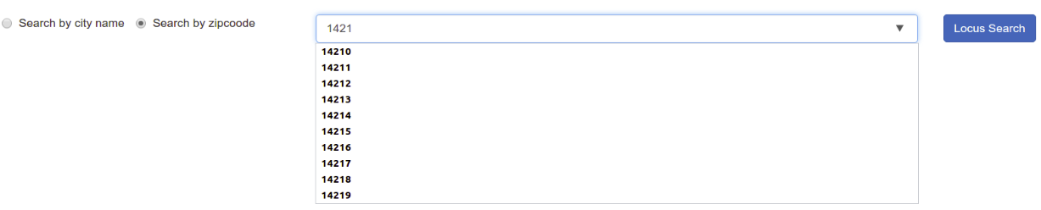
Unfamiliarity with new location
Database consists of 29,470 unique locations in United States
Auto suggest cities and zip codes as user types in the location

Slide 8
Datasets
Data acquisition
Using location dataset obtained from simplemaps.com
State code to state name mapping from Wikipedia
Data is present in CSV format. Example,
Data cleaning
Empty values
Syntactically invalid data for latitude and longitude.
Example, latitude = TG35.745
Implemented java program to omit such values.

Slide 9
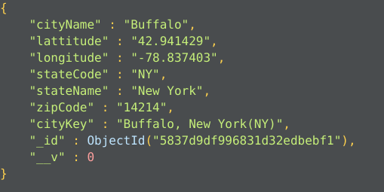
Datasets (continued)
Data transformation
Need to transform the data from CSV to JSON objects such that it can be stored in MongoDB
Implemented java program to transform the each entry in CSV file to JSON object
Example of location entry in Mongo DB

Slide 10
Data integration query problem
Use schema mappings
Users
User enters query
Consolidated results
Public interface with target schema
Schema mappings
Source databases over source schemas

Slide 11
Approach
Users
Query- User Enters location
Display consolidated data as a query result
Locus App
Schema mapping - Consolidate data into a target schema
Fetch best places to eat
Fetch weather conditions and forecast
Fetch interesting places to explore
Fetch popular nearby events
Weather Data (Underground)
Restaurant Data (Yelp)
Event data (Eventful)
Interesting places (Foursquare)

Slide 12



System architecture
Locus app
Yelp Endpoint
Trigger events to fetch data for <location>
/api/yelp/<location>
Search for <location>
Weather Endpoint
Client Engine (Angular2)
Server Engine (Node)
/api/weather/<location>
Display result
Get consolidated data
/api/event/<location>
Users
Browser Clients
Eventful Endpoint
Port:3000
Port:4000
/api/foursquare/<location>
Retrieve location object from <location> from database
Location Data
Foursquare Endpoint
Asynchronous Calls
Synchronous Calls
Port:27017

Slide 13
Algorithm
User enters location - either city name or zip code.
Server validates the location and retrieve location object from MongoDB belonging to the user entry.
Using attributes in location object, we get data from yelp, weather underground, eventful and foursquare asynchronously.
Data obtained from the above step is mapped to the target schema i.e. HTML layout of the result page.
Results are shown to user by rendering HTML content obtained in step 4.

Slide 14
Design choices - MEAN stack
Front End - Client Engine
HTML/CSS : Layout of a search and results page.
Angular2:
Provides MVC framework - helps modularizing code
Implementing different components and services.
Bootstrap: Styling and user interface components
Back End
Server Engine
Node JS: Application server
Express JS: Framework for running server.
Database
Mongo DB: Storing all locations as JSON object.

Slide 15
Design choices - Programming languages
Typescript for writing components and services in Angular2
Easy to write classes and injectables services in typescript
Easier to debug - typescript files are converted to javascript files after compilation
Javascript for implementing APIs in node JS
Well documented
Java for data cleaning and data transformation
Expertise and previous experience

Slide 16
Technical Contributions
We have considered granularity of location
Feature to search by city name or zipcode
Implemented auto suggest feature
Solved data integration query problem using schema mappings
Mashing up the relevant details to plan the trip & provide a one stop solution

Slide 17
Schema Mapping
Schema mapping is done for 4 components viz.
Weather component
Yelp Component
Event Component
Foursquare Component

Slide 18
Weather component
Input: StateCode and City Name attribute of location object
Eg. StateCode = NY and CityName = Buffalo
Output: Current weather and weather forecast for next 3 days
Output format: XML or JSON
We have chosen JSON. Easier to deal with in Javascript.
Using weather underground API

Slide 19
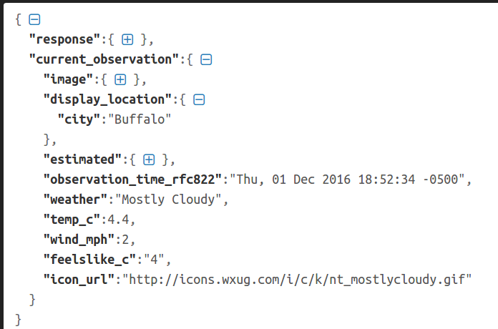
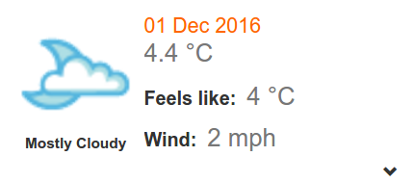
Weather component - Mapping
Source
Target

Slide 20
Yelp component
Input: Latitude and Longitude of location object. Radius of location is fixed to 20 miles.
Eg: latitude = 37.78 and longitude = -122.41
Output: Top 20 best places to eat around 20 miles radius of location entered by user.
Output format: JSON
Implemented using Yelp Search API

Slide 21
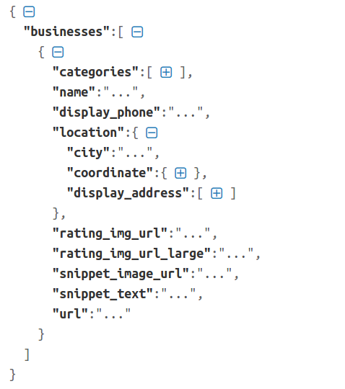
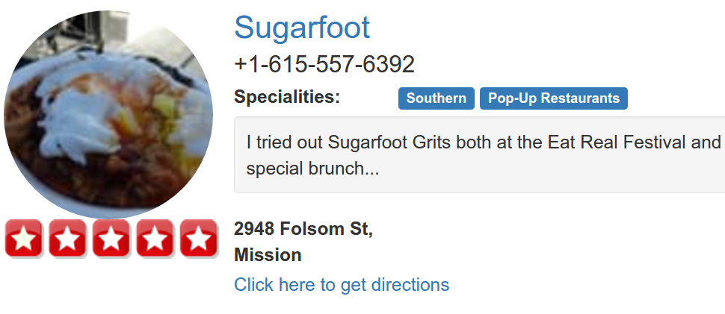
Yelp component - Mapping
Source
Target

Slide 22
Event Component
Input : Latitude and Longitude of location object
Eg: latitude = 37.78 and longitude = -122.41
Output: Events happening in the city sorted by popularity
Output format: XML or JSON
We have chosen JSON. Easier to deal with in Javascript.
Output can also be restricted to certain types of events like Music etc.
Using Eventful API

Slide 23
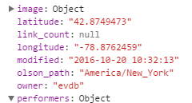
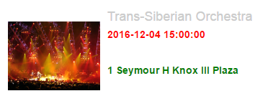
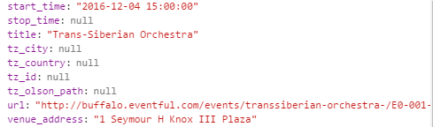
Event component - Mapping
Source
Target

Slide 24
Foursquare Component
Input: City Name Or latitude and longitude attribute of location object
Eg: CityName = San Francisco OR
latitude = 37.78 and longitude = -122.41
Output: Must visit places & things to do in the area
Output format: JSON
If input is Lat-Long, places within 20 miles radius are displayed
Implemented using Foursquare Explorer API

Slide 25
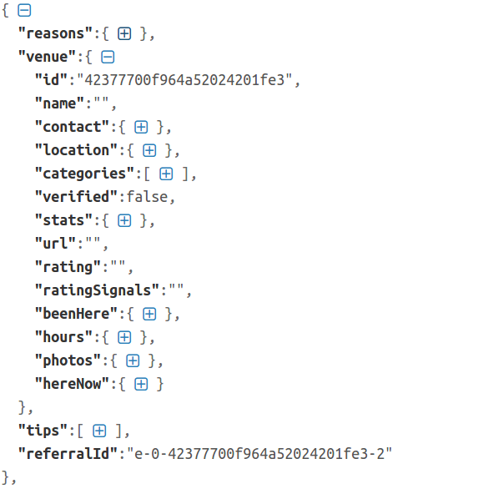
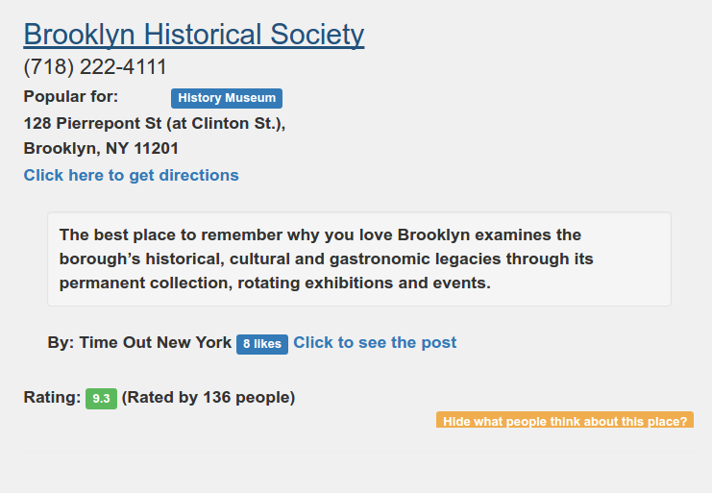
Foursquare component - Mapping
Source
Target

Slide 26
User Interface
A good UI/UX Design
Understanding the audience.
Different design for commercial & non-commercial users
Visual Representation & hierarchy.
Simple Forms.
Simplicity & Consistency.

Slide 27
User Interface- How it influenced us
A good UI/UX Design
Understanding the audience.
Application targets non-commercial users.
No API designing.
No user registration.
Nothing requires managing access policies. All the content is available to all the users across the application.

Slide 28
User Interface- How it influenced us
A good UI/UX Design
Visual Representation & hierarchy.
Precise flow of information representation.
Weather component kept at top, as it is major travel decision influencer.
Next is Places to visit => Would always be top reason for the plans.
Places to eat.
Events happening, user might be looking for specific events but it’s less likely than other components.

Slide 29
User Interface- How it influenced us
A good UI/UX Design
Simple Forms.
Only a search box.
No registration/login means no clutter. Also keeps the application simple.
User can enter various location identifiers:
Zipcode
City name

Slide 30
Basic Concepts (Things we will discus)
MVC framework which powers the app.
Angular 2 terms.
Node.js terms.

Slide 31
Basic Concepts- MVC Framework
What is MVC framework?
Model-View-Controller
Separates application into three components
The Model, The View & The Controller
Provided scalability & extensibility.
Industry standard framework.

Slide 32
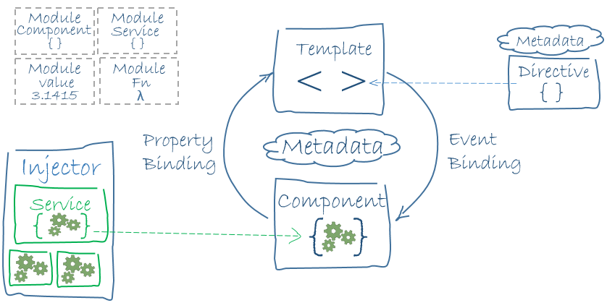
Basic Concepts Angular 2 Terms

Slide 33
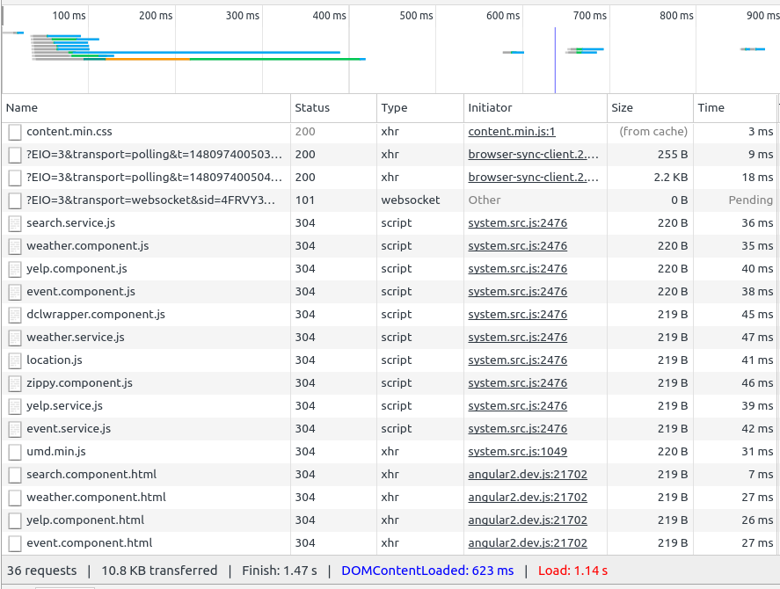
Experimental Evaluation - Page load

Slide 34
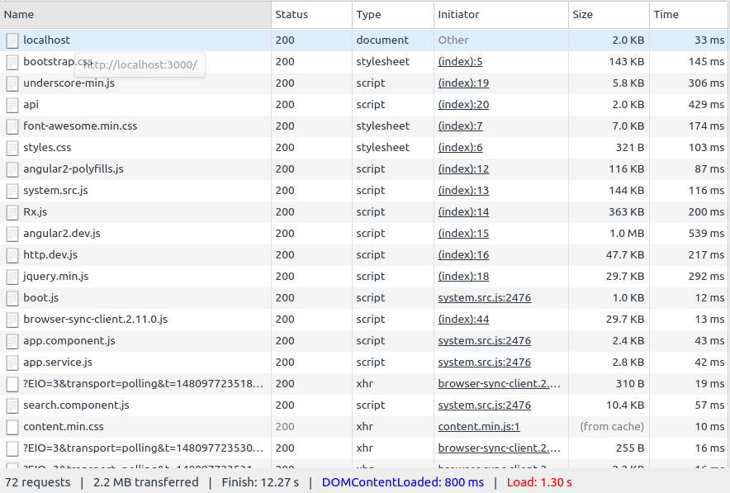
Experimental Evaluation - Query response

Slide 35
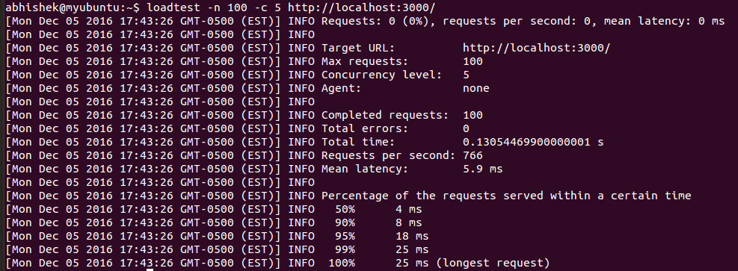
Experimental Evaluation - Load testing

Slide 36
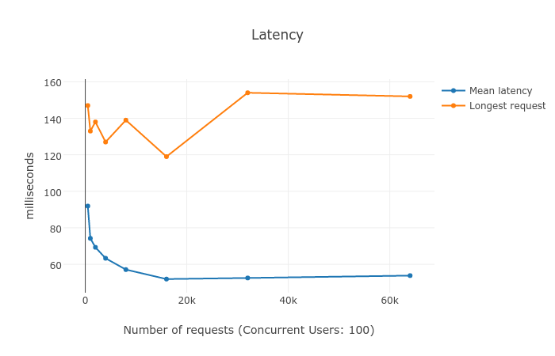
Load testing - results

Slide 37
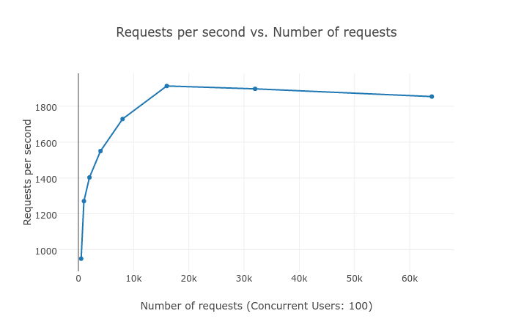
Load testing - results

Slide 38
Hardware and Software platforms
Development environment specifics
Hardware platform
Ubuntu 14.04 LTS 64 Bit
Intel® Core™ i7-5500U CPU @ 2.40GHz × 4
8 GB RAM
Software platform
IDE: Visual Studio
Browser: Chrome and Firefox
Server: Node, Express Framework.
Database: Mongo DB

Slide 39
Limitations of proposed approach
There are still certain limitations that needs to be addresses like
Possibility of providing service for planning the trip in advance.
Margin of improvement in Events to accept dates and show all the events for particular date.
Events can also be grouped based upon places and gives user ability to see if any events happening at particular place.

Slide 40
Limitations of proposed approach
There are still certain limitations that needs to be addresses like
Top places to eat are being fetched from single API.
For more data reliability, future improvements would involve multiple APIs being used & an algorithm to judge and normalize the rating.

Slide 41
Limitations of proposed approach
Same goes for the Places, can also be fetched from multiple APIs
Expedia stopped new registrations.
Hampered our plans to integrate data from multiple sources for the same component.

Slide 42
Challenges
API limitations
Number of requests per day, requirement of different location attributes etc.
Data acquisition and transformation
Acquiring location data and transforming it to make it useful for our application
Data integration
Designing target schema and schema mappings for components
User interface
Building UI components like auto suggest, zippy component from scratch

Slide 43
Summary
Built one service to mashup relevant data about location
Useful when user is unfamiliar about new location
We have built lucid user interface with the features like
Auto suggest as user types in location
Zippy component to show or hide weather forecast based on user action
Clear user interface to show weather, restaurants and events.
We have solved data integration query problem
Integrated data from four different data sources viz.
Weather underground
Yelp
Eventful
Foursquare

